Slide 1


Sunbeam College
for Women
Flood Risk Management
{Minor Project}
Creator
Ms. Akanksha Kumari
Supervisor
Mrs. Anita Shah

Slide 2

Public FLOOD Emergency and Awareness service

Slide 3
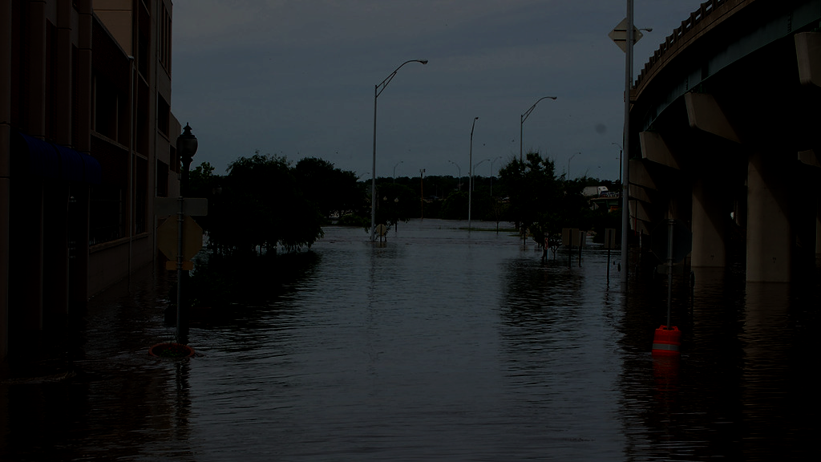


The completion of this project would have been not possible if not dependent on the dedicated support and encouragement of my project supervisor “MRS. ANITA SHAH” who provided me the opportunity to do such a project and there guidelines to work on this wonderful project. I would like to give my thanks of gratitude to all the other faculty members of the department.
For their inspiring intellectual guidance, constructive criticism and valuable suggestion throughout the project work.
Lastly, I should like to express my deep apperception towards my classmates and parent for providing me the moral support and encouragement.
Acknowledgement
Special Thanks
Mr. Daya Shankar,
Saurabh, Pankaj, Ashish, Ananya

Slide 4
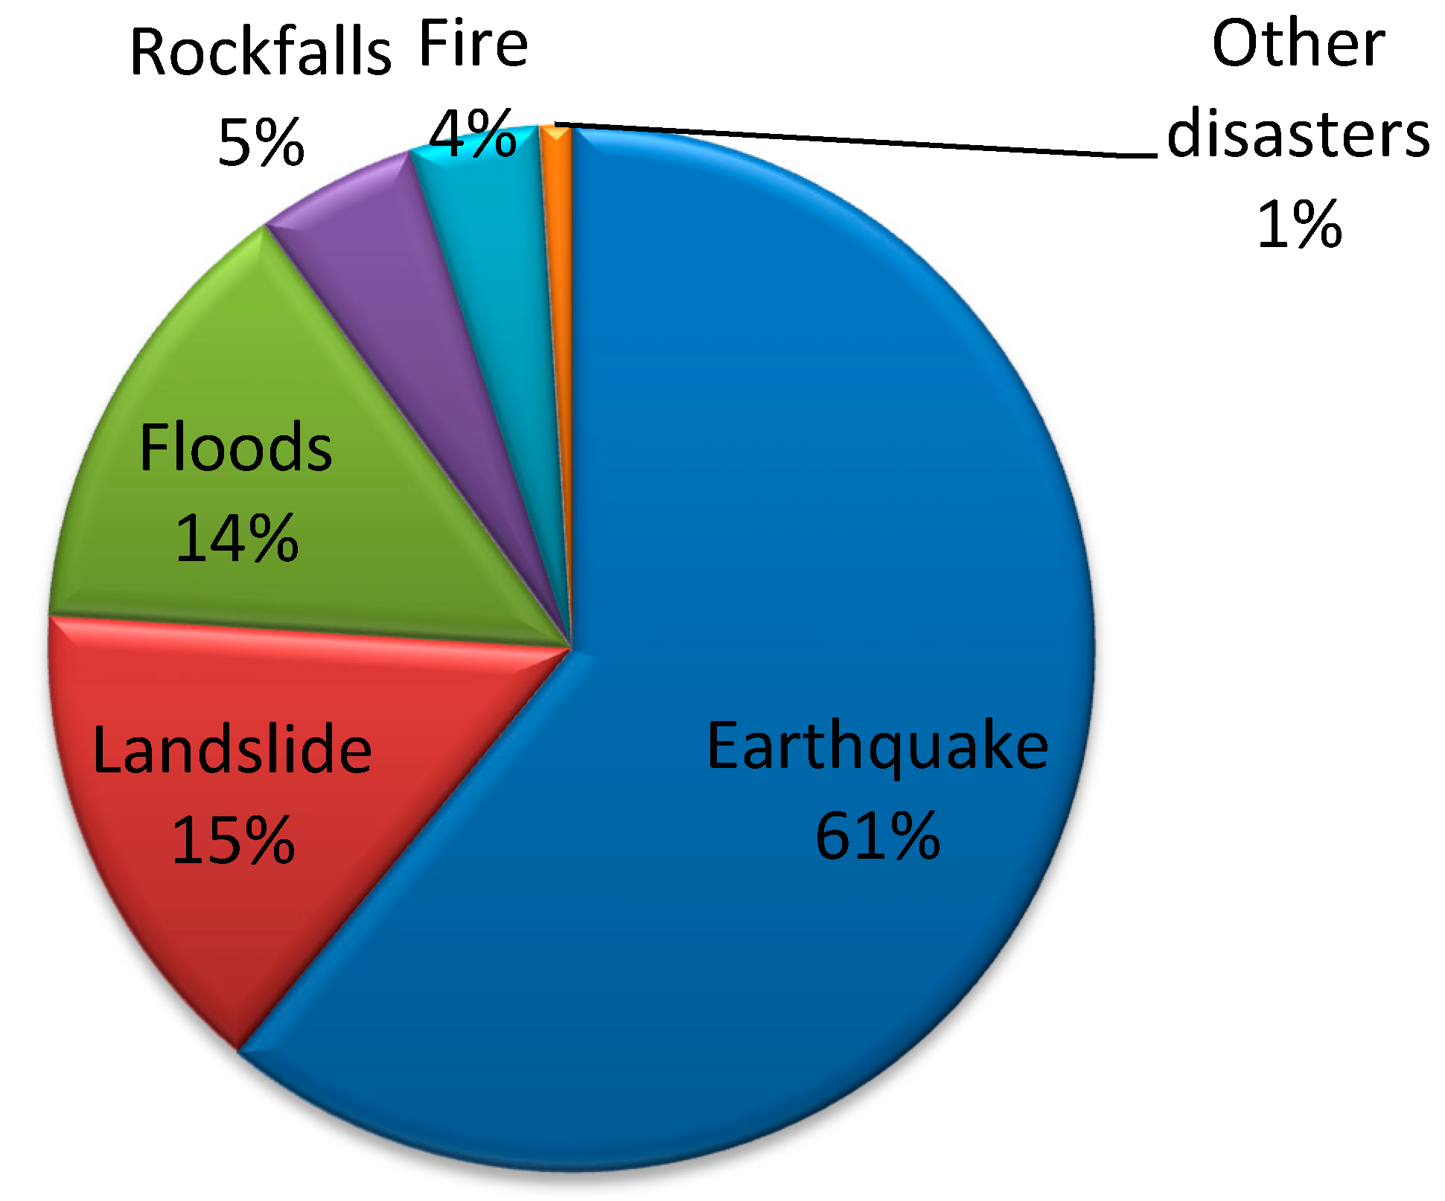
What is Disaster Management
Disaster Management can be defined as the organization and management of resources and responsibilities for dealing with all humanitarian aspects of emergencies, in particular preparedness, response and recovery in order to lessen the impact of disasters.

Slide 5
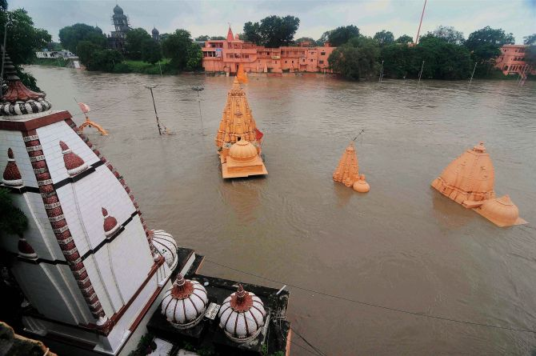
Why Flood Risk Management
To improve the systems of warning and emergency communications
To provide support for the public authorities and government institutions’ hazard mitigation efforts, including planning and action coordination
To inform the public on the risk exposure to natural hazards and how they can get prepared, respond, recover and mitigate the impacts of such events

Slide 6
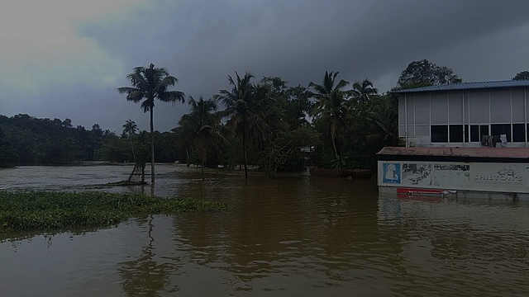

Scope
The Flood serv set out a sustainable, long-term strategy to manage the flood risk within each River Basin, focused on the areas of potentially significant flood risk and the sources of flooding giving rise to that risk.
The Flood Serv set out the range of policies and measures, which are in place, under development or proposed that contribute to the reduction and management of flood risk throughout the River Basin.
Guidelines
There’s a need to have all numbers to hand as part of your flood emergency kit.
If you need to stay with friends or family during a flood having a number to contact them will be vital.

Slide 7
Software Requirements
Operating System: Window XP, 2003, 2007
Platform: Visual Studio Code
Tools: Mongodb Compass
Front-End: HTML5, CSS3, Bootstrap, JavaScript
Back-End: Express.js, Mongodb
Framework: React.js
Server: Node.js
Browser: Internet Explorer, Google Chrome, Mozilla Firefox etc.

Slide 8
Hardware Requirements
Monitor: VDU
Processor: Intel Core i3 generation (speed 2GHZ or High)
RAM: 128 MB RAM
HDD: 20 GB HD CD-ROM
DRIVE: 52X

Slide 9
Site Map
Homepage
News
FloodHelpo
Contact Us
About Us
Donation Portal

Slide 10
Modules
Guidelines
Information
Sharing
Donation
Emergency Service
Weather
Forecast

Slide 11
Components
Contact Us
Donate to help
Government Guidelines
Emergency Kit
Weather Forecast
Flood Bulletin

Slide 12
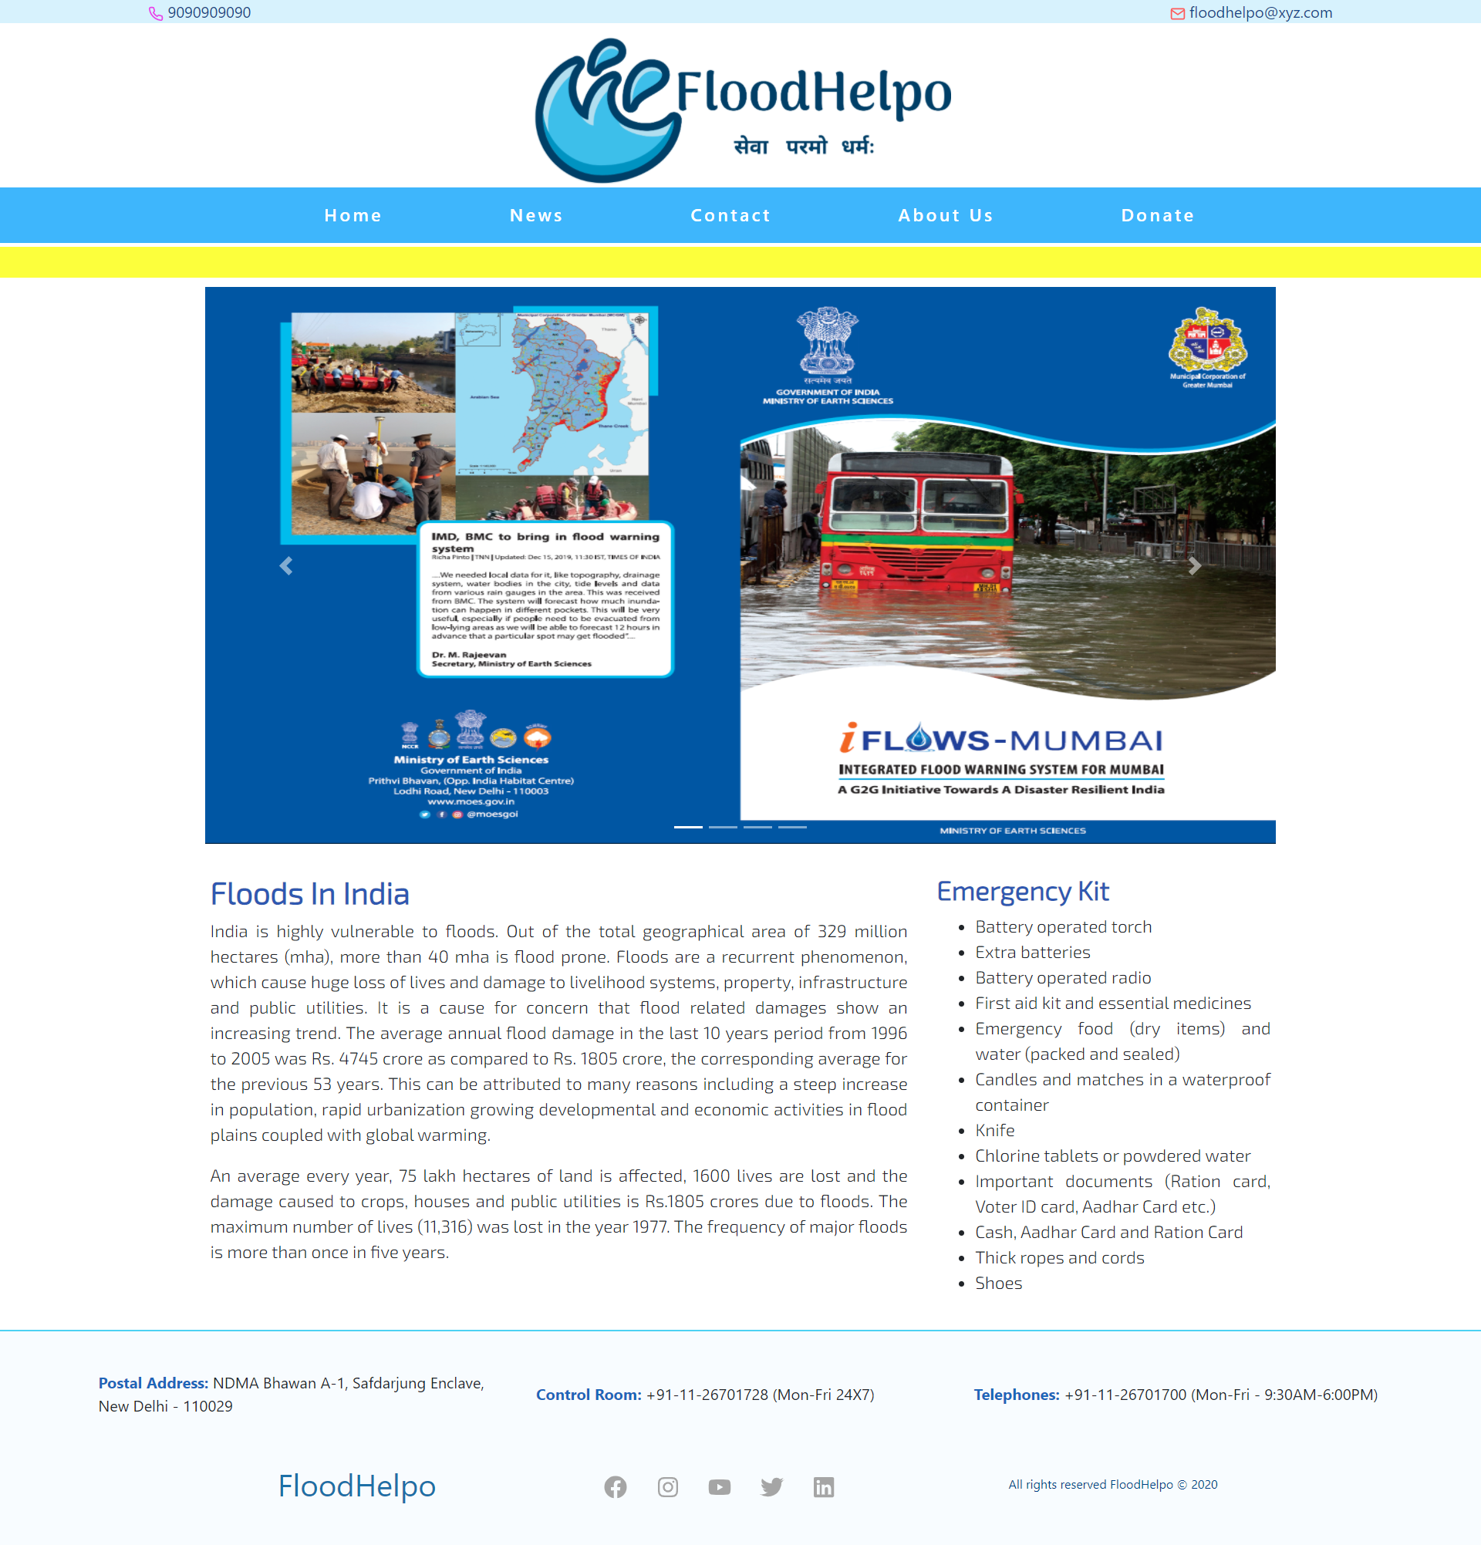

Slide 13
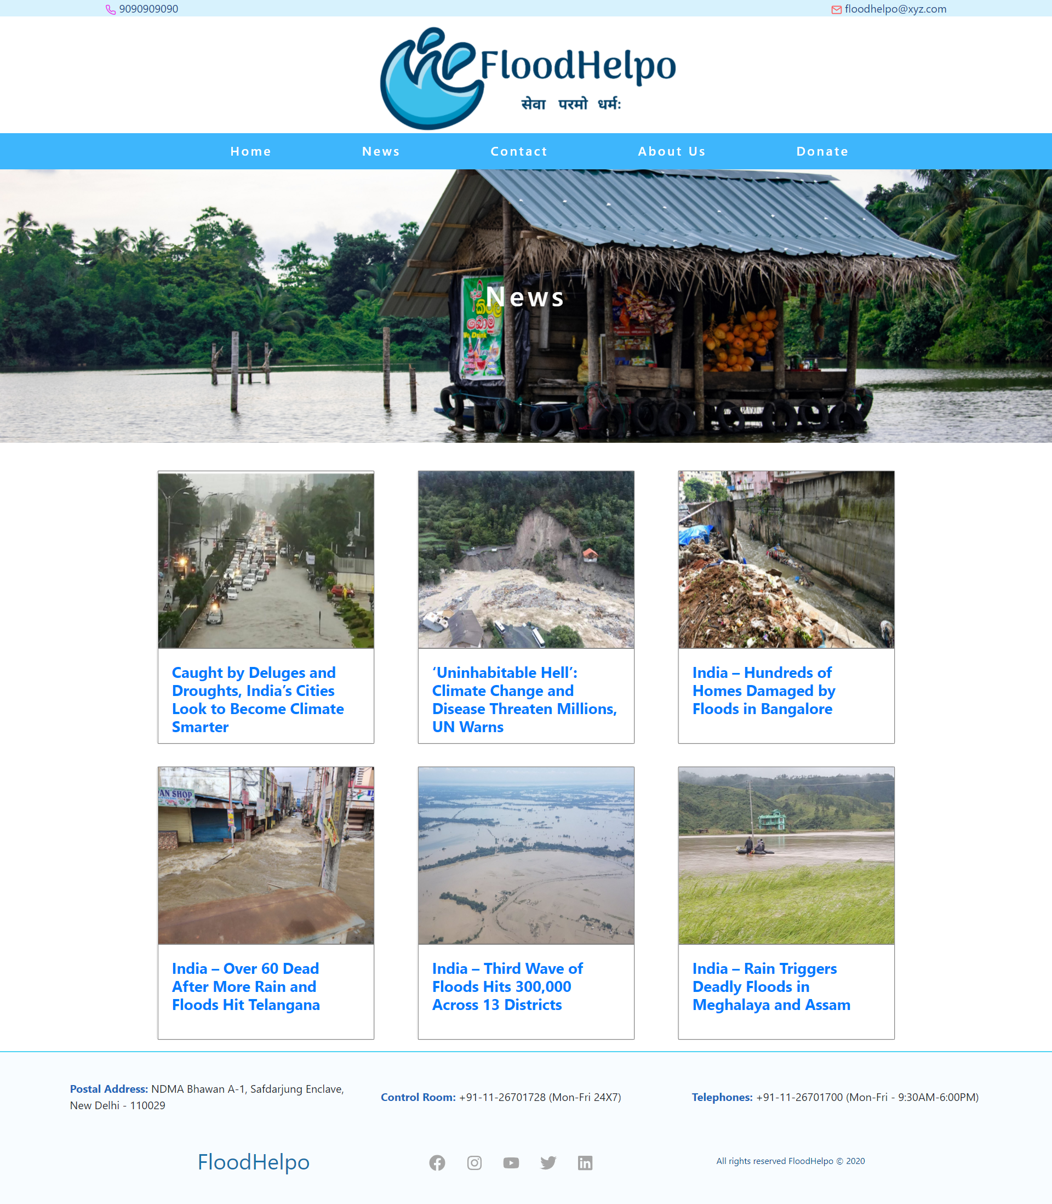

Slide 14
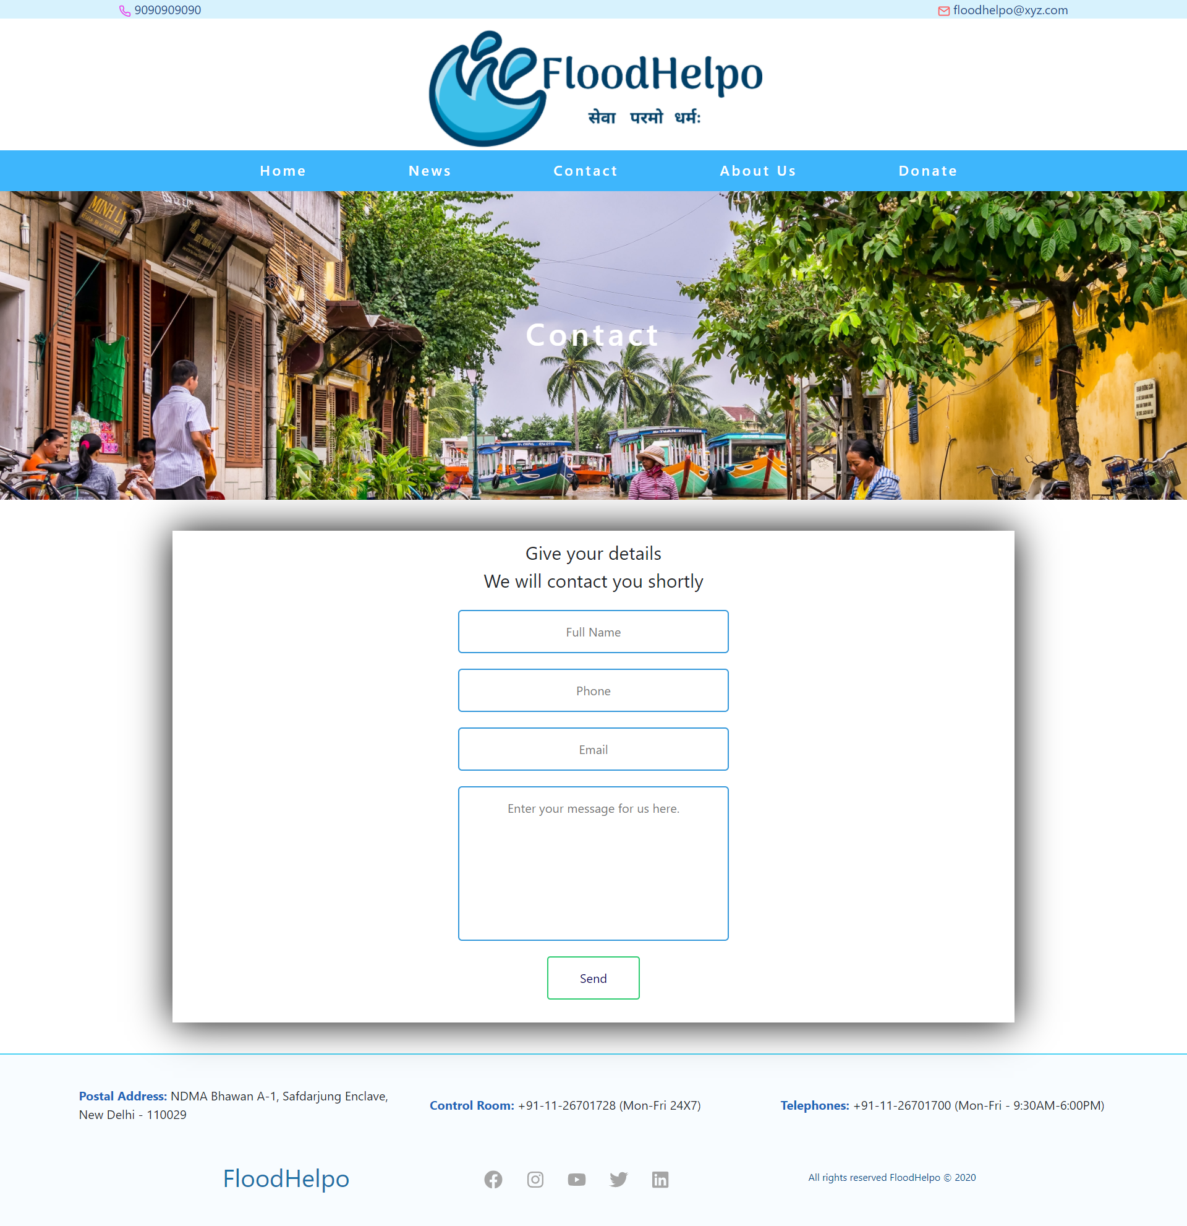

Slide 15
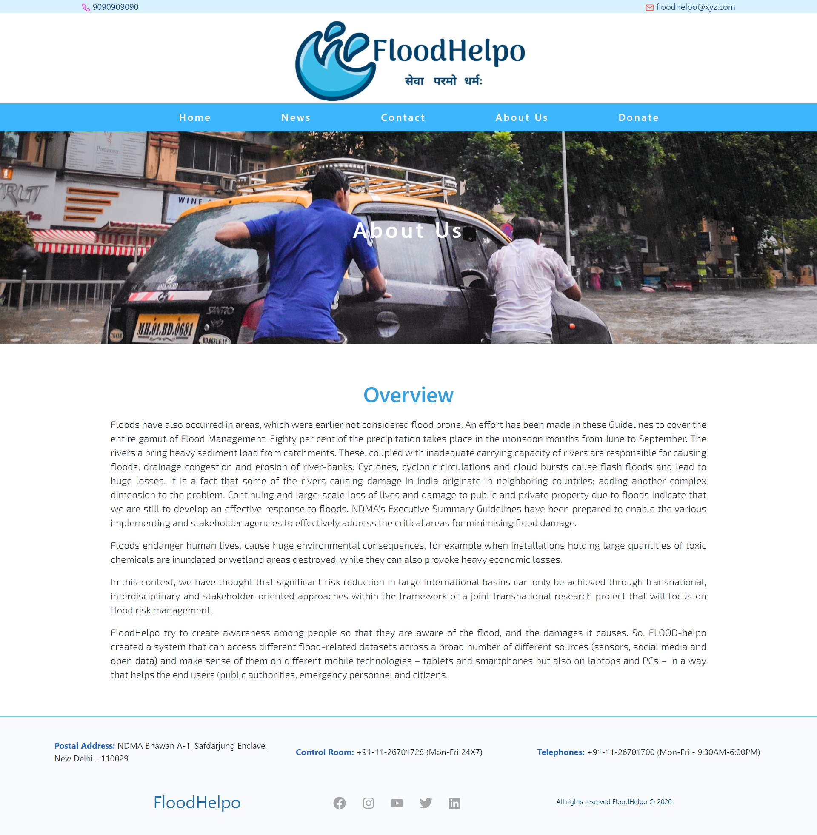

Slide 16
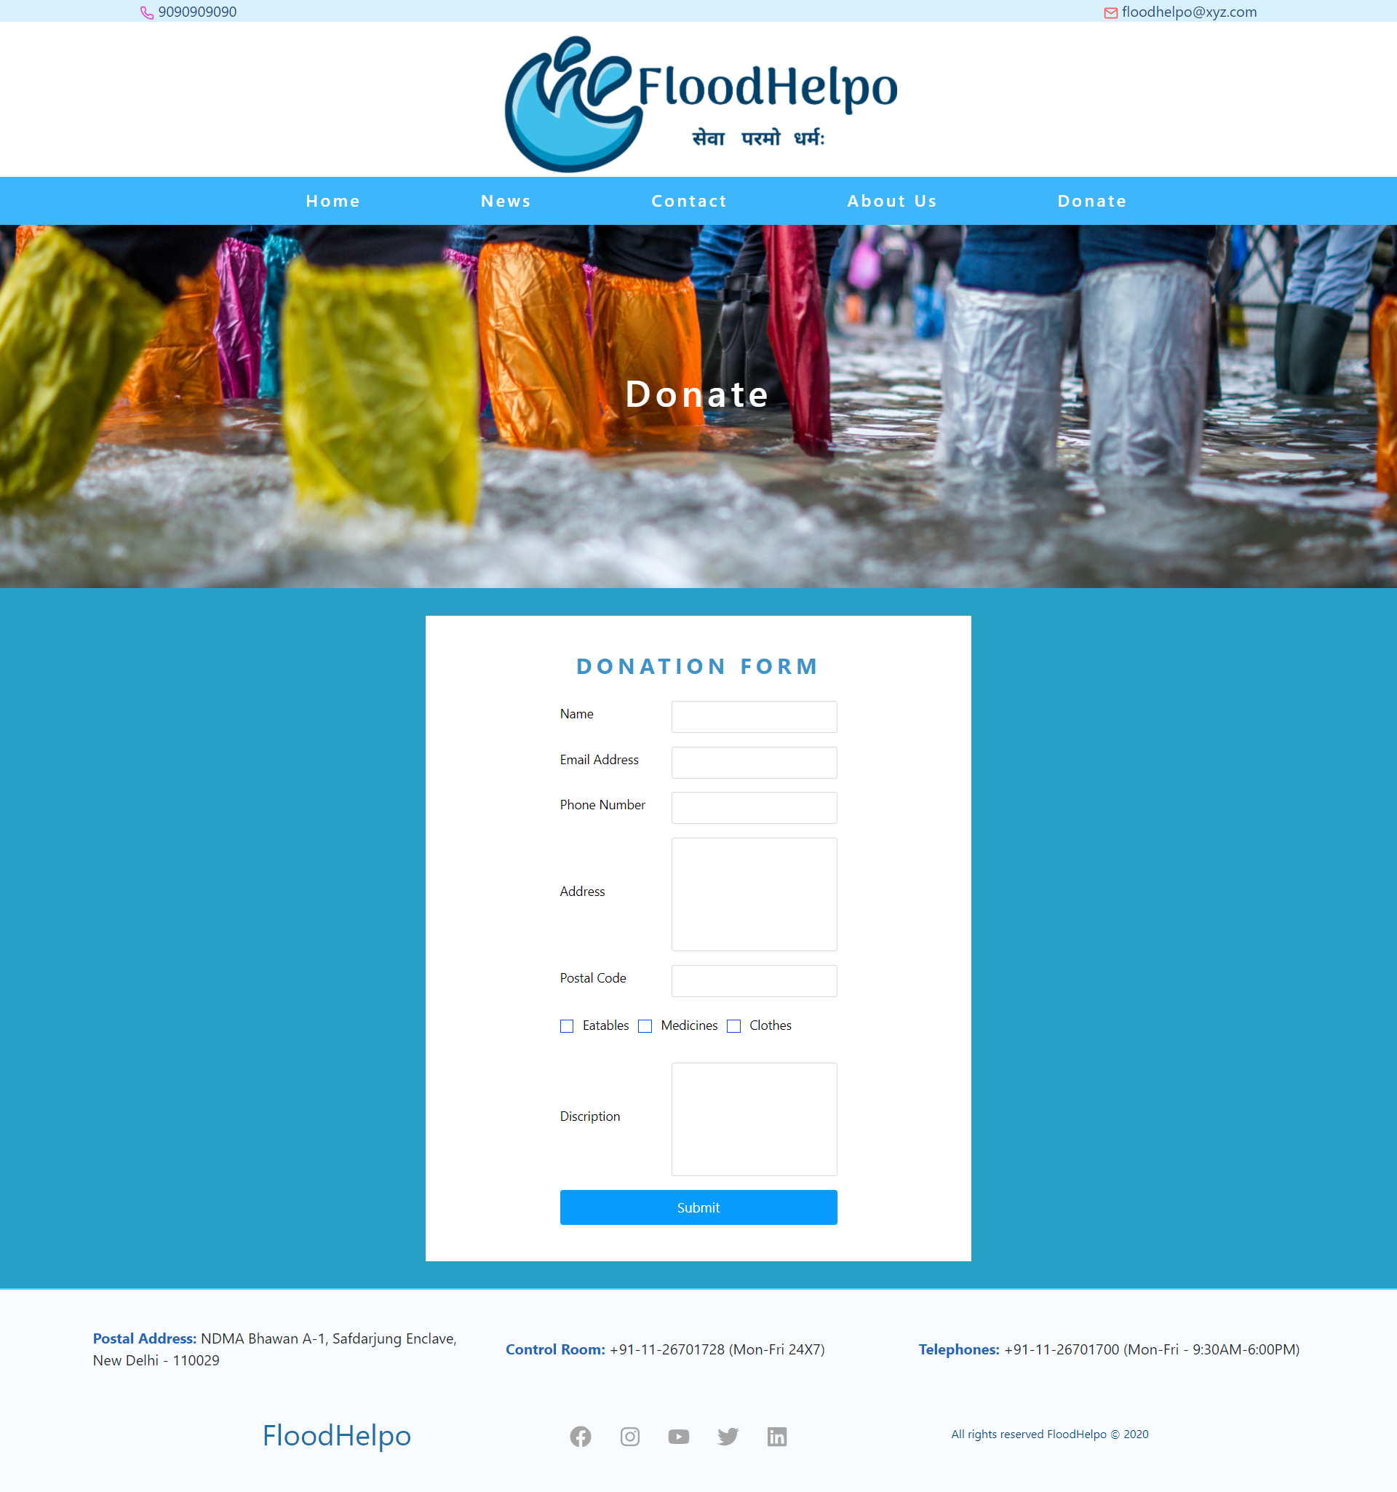

Slide 17
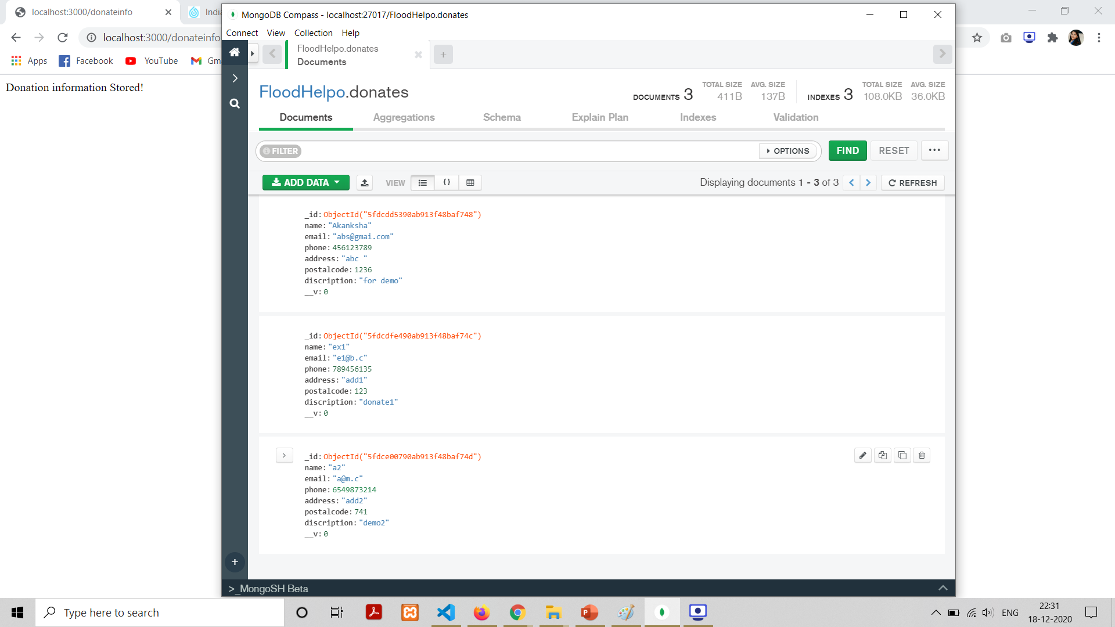
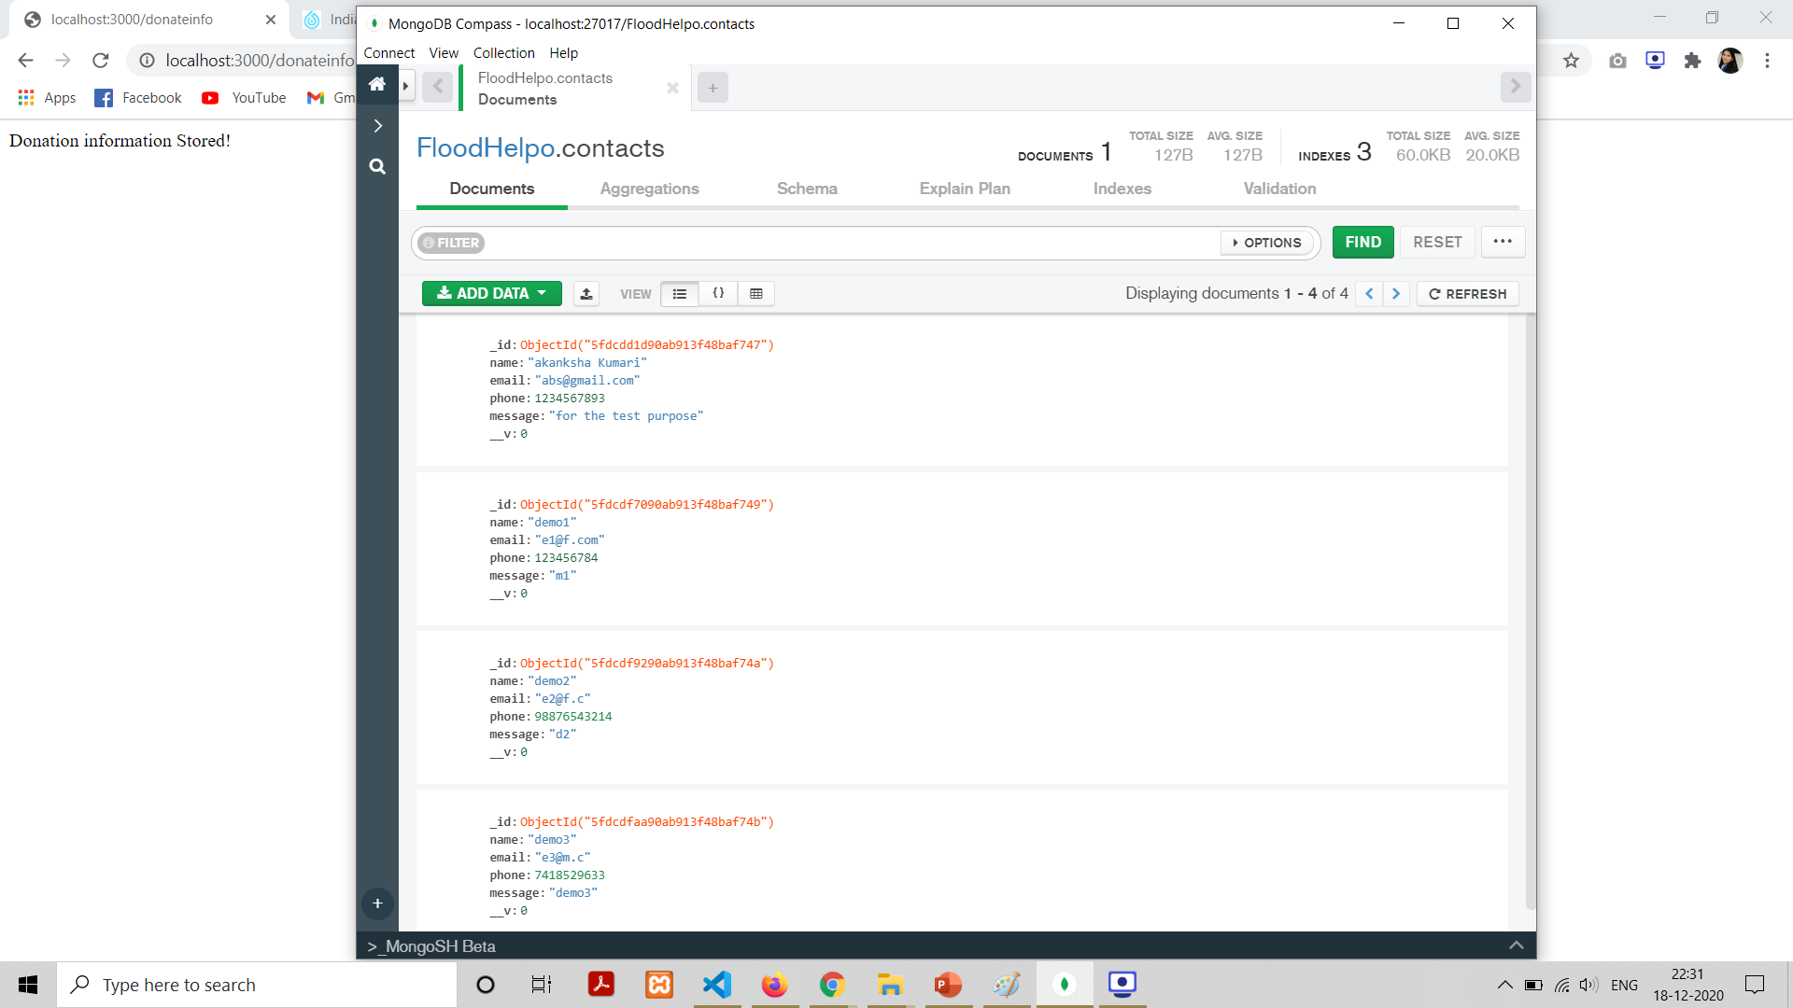
Donation Form Schema
Contact us Form Schema

Slide 18
Help Desk
Admin Login
Shelter Homes
Current Scenario
Water Level
Animal Rescue
For the people who are in immediate need
Admin portal to update the data
Information about the vacant homes.
 |  |  |  | FUTURE ENHANCEMENT
Updates could be made through live API
Information about the river basins water flow
Safeguard the animals who are affected

Slide 19

The website is special design for the reach of basic information about Flood prone areas.
The elemental problem faced by the lifes ,encourage people to do something regarding respective conditions.
CONCLUSION
The project will reach not only the people affected by floods and stakeholders in the field of water management, spatial planning, crisis management (civil protection), economic affairs, public health, environmental protection but also those who may not be so intrinsically motivated to participate in the flood risk management process.

Slide 20
What people are saying
We learn from every natural disaster. Whether it's a fire or a flood, we learn something from it so we can respond to the next one better.
Malcolm Turnbull
While natural disasters capture headlines and national attention short-term, the work of recovery and rebuilding is long-term.
Sylvia Mathews Burwell
War zones are dangerous, protests can be violent, also, natural disasters are difficult to cover, so there are going to be risks.
Kate Adie

Slide 21
Thank You !!

